Slide 1
Team 7: Portable and Inexpensive Fluorescence Imaging for Traumatic Brain Injury Diagnostics
Akash Canjels, William Livingston, Karthik Raj,
Justin Yeung
Notes:
Hello, my name is Will, and I am with Akash, Karthik, and Justin. We are part of the UCSD Bioengineering Department and are Team 7 of the Senior Design Project. Our project is (state title)

Slide 2
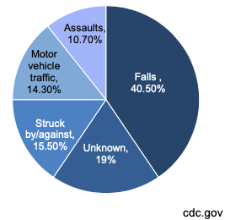
Traumatic Brain Injury (TBI) Background
Sudden injury to the body or brain that leads to brain damage
Types include contusion, concussion, penetrating injury, and anoxic injury
Affects 1.5 million Americans annually (70 million worldwide)
30 years of clinical trials, still no therapies that provide long-term benefits to brain health
Notes:
Will

Slide 3
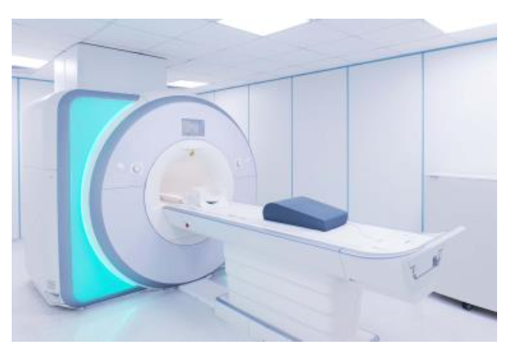
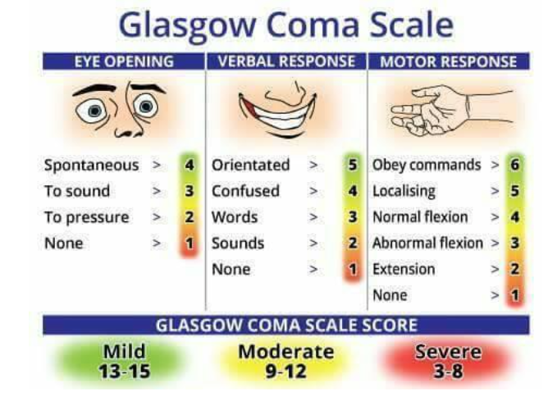
TBI Diagnosis Methods
CT scan/MRI
Medical imaging, industry standard
Time-intensive, immobile
Glasgow Coma Scale
Behavioral test, Qualitative
On-site physicians and expert reviewers disagree on diagnosis
Notes:
Will

Slide 4
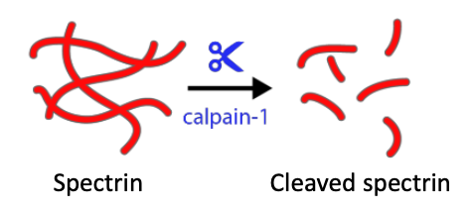
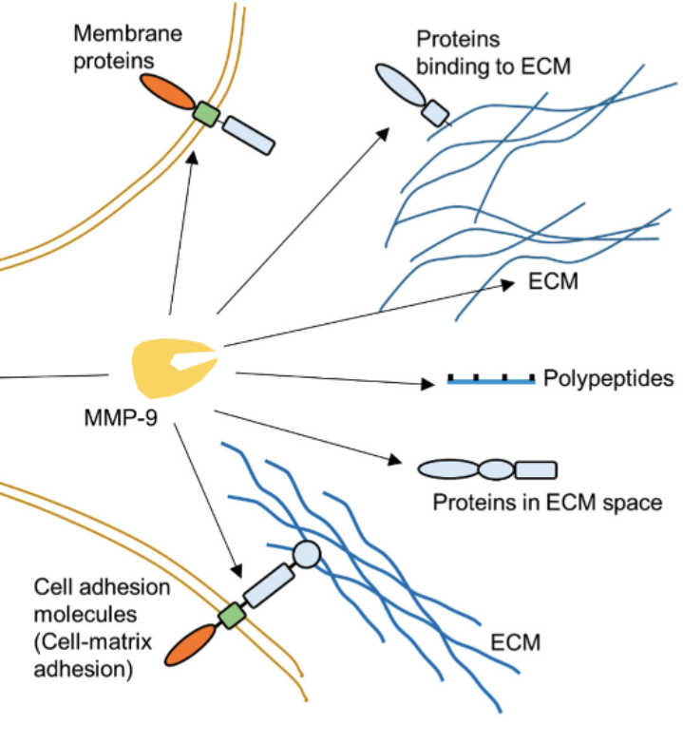
TBI Biomarkers
Within minutes of brain damage, biomarkers Calpain-1 and MMP9 are upregulated
Calpain-1 is an enzyme that breaks down cytoskeletal proteins
MMP9 is an enzyme that breaks down ECM proteins
Basically, Calpain-1 and MMP9 upregulation means neuron death
Kudryashev et al, ACS Sensors 2020
Hao Huang, Biosensors 2018
Notes:
Will

Slide 5
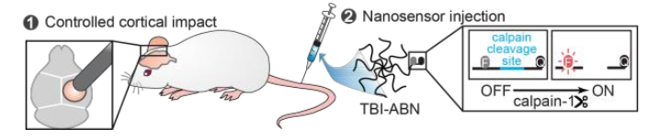
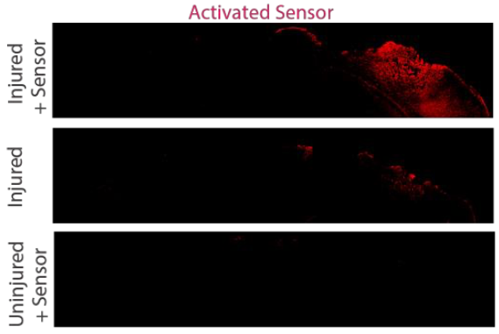
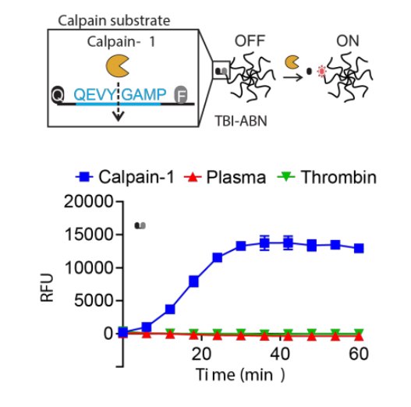
Engineered Activity-Based Nanosensor
Previously, the Kwon Lab created a calpain-1 specific probe to be cleaved (a fluorescent nanosensor)
Measuring the amount of cleaved probe rather than calpain-1 itself
Called a nanosensor since amount that enters the brain is size-dependent (5-10nm)
Previous design utilized FRET for in vivo diagnostics
Fluorescence signal increases with increased calpain-1 activity
Kudryashev et al, ACS Sensors 2020
Notes:
Will

Slide 6
Engineered Activity-Based Nanosensor
How do we utilize the technology developed for portable and inexpensive diagnostics?
Redesign probe from FRET sensing to analyte that can be capture in vitro via antibodies
Sample taken from patient in blood or urine
Attach fluorescent marker for quantitative measurement
Solution: Fluorescent Lateral Flow Assay! (LFA)
Kudryashev et al, ACS Sensors 2020
Notes:
Will

Slide 7
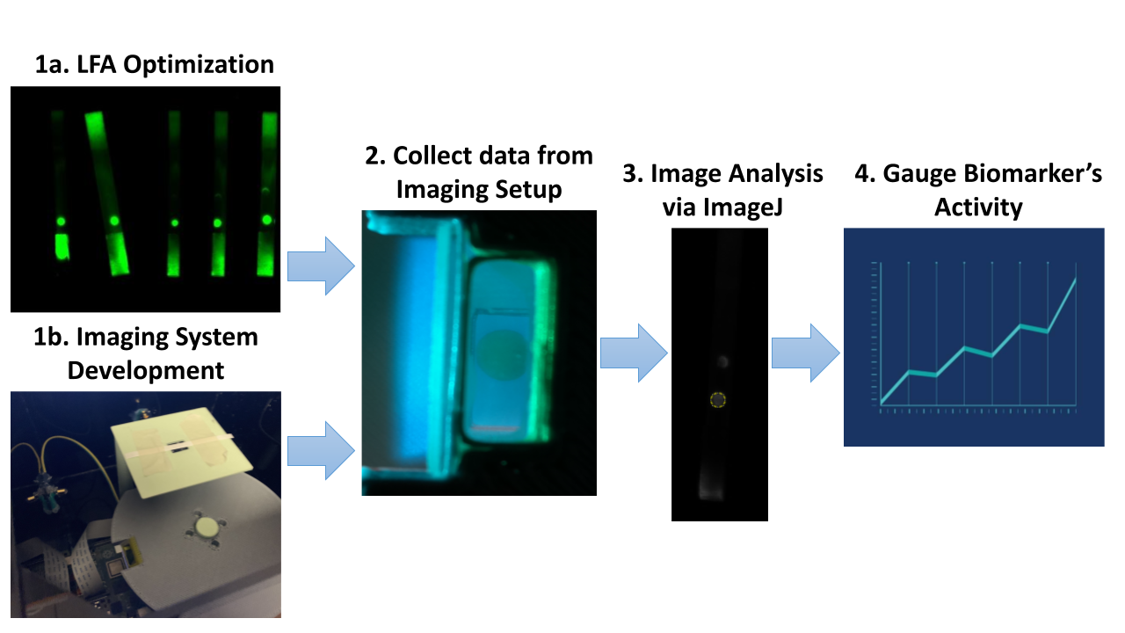
Project Overview
Notes:
Karthik

Slide 8
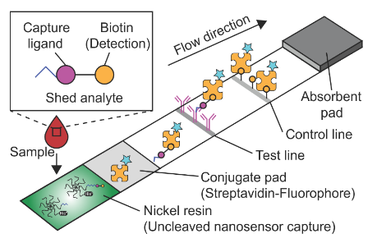
How the LFA Works
-Transition from in vivo imaging to in vitro analysis
-Multiple components: sample pad, conjugate pad, test line, control line, absorbent pad
-Conjugate binds to both the control line and shed analyte
-Capture ligand: fluorescein amidite (FAM)
-Fluorescence signal increases as a function of increased binding of labeled analyte or conjugate
Notes:
Justin

Slide 9
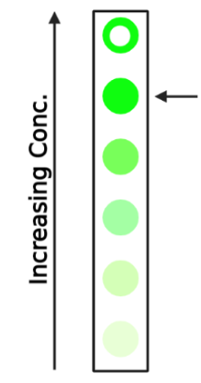
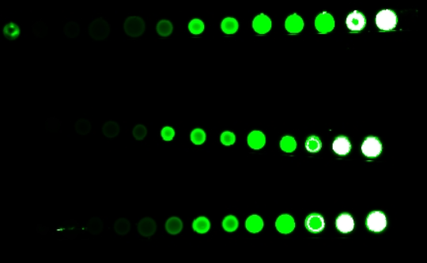
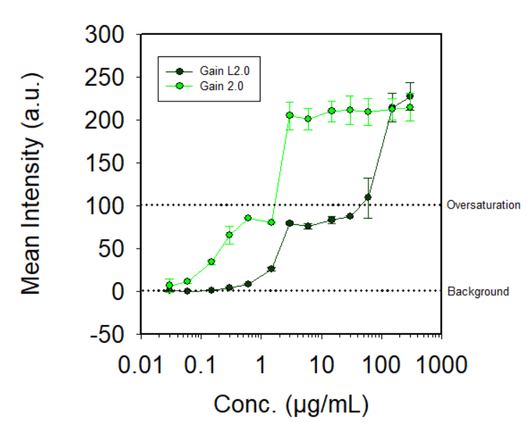
Characterization of the Reporter Molecule
-Challenge: fluorescence quantification instead of colorimetric binary assay
-Imaging using Kwon lab’s Odyssey LI-COR fluorescence scanner using 800 nm excitation
-Determine ideal concentration of streptavidin-fluorophore to be used in conjugate pad
Notes:
Justin

Slide 10
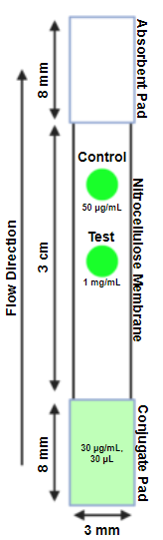
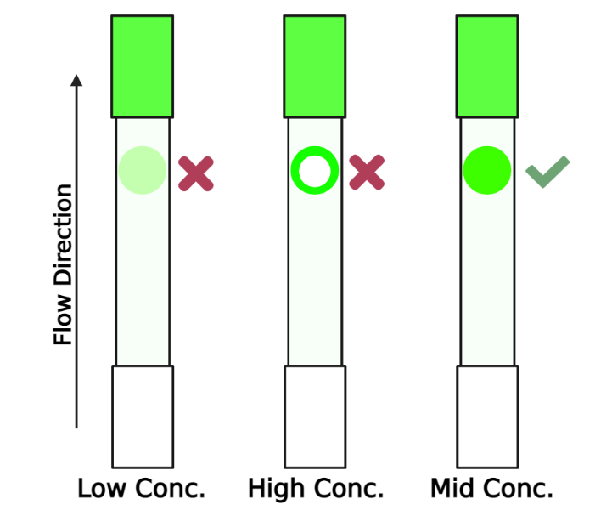
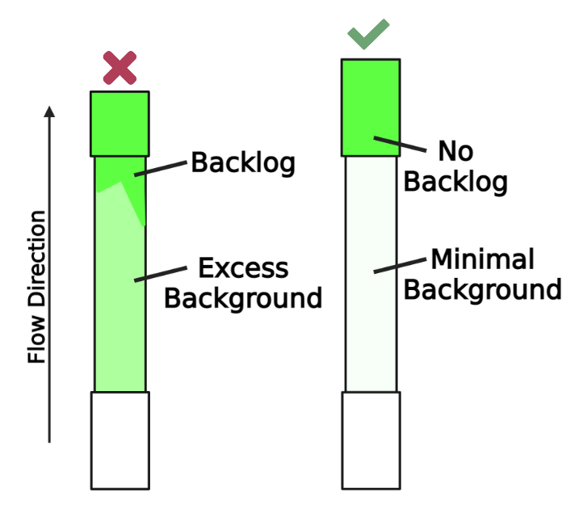
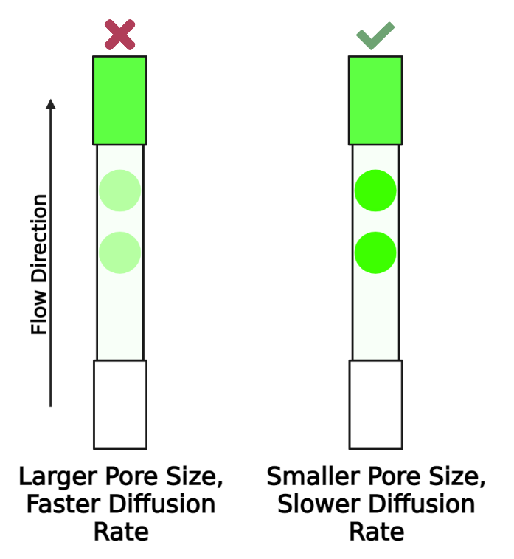
LFA Optimization
Flow Optimization
Ensure absorbent pad is large enough to absorb entire sample to avoid backlog of reagents and excess background. A length of 8mm was used.
Binding Time
Determine the optimal pore size and length of nitrocellulose membrane to allow for adequate binding and capture of reagents. Our assay uses a membrane with a flow rate of 105-150s/3cm.
Control Zone
Determine the optimal concentration of BSA-Biotin used in control zone for strong and consistent signal without oversaturation. A concentration of 50 µg/mL was used.
Notes:
Justin

Slide 11
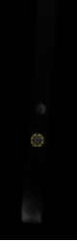
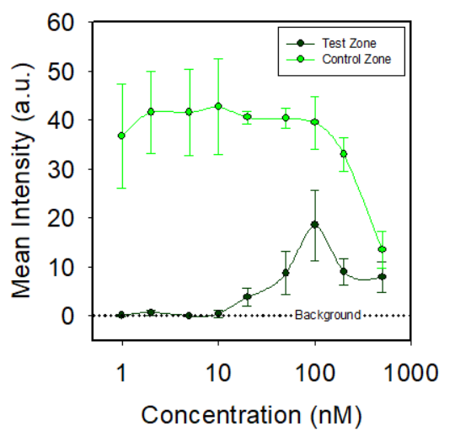
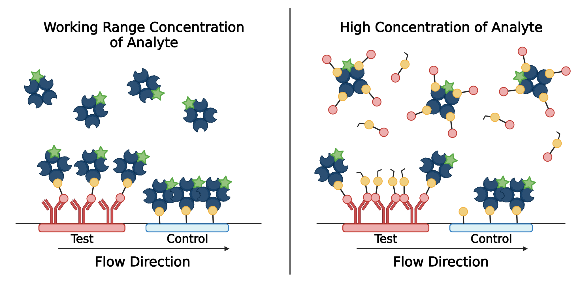
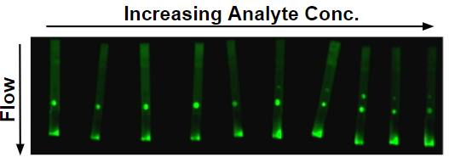
LFA Characterization
-ImageJ analysis of LFA strips to quantify signal of control and test in greyscale
-Tested LFAs using increasing concentration of cleaved analyte
-Detection range: 20-100 nM
-Significant signal drop after 100 nM due to competitive binding
Made with Biorender
Notes:
Justin

Slide 12
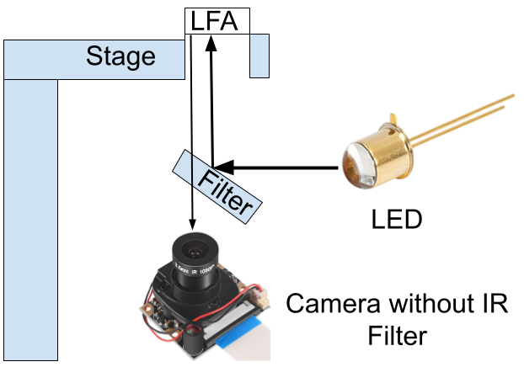
Imaging Setup Design
Components | Price
Raspberry Pi | $97
Dichroic Filter (495 nm) | $165
LED (490 nm) | $12.24
Camera | $16.99
Wiring & 3D Printed Parts | $15
Acrylic Sheets for Box | $46.20
 | Total: $352.43
Notes:
Akash

Slide 13
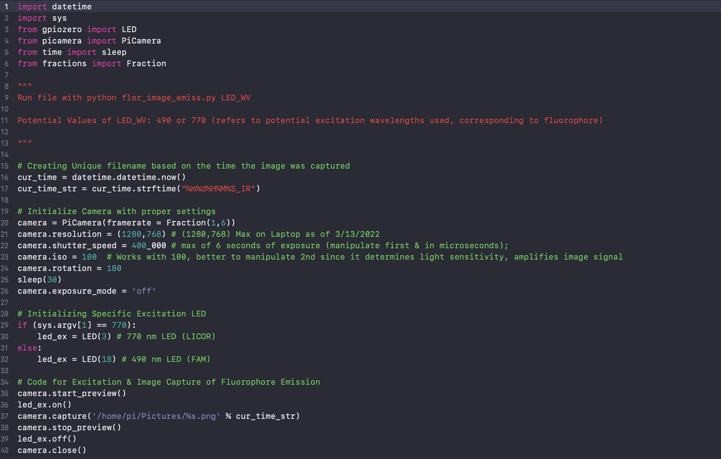
Raspberry PI Code
Notes:
Karthik

Slide 14
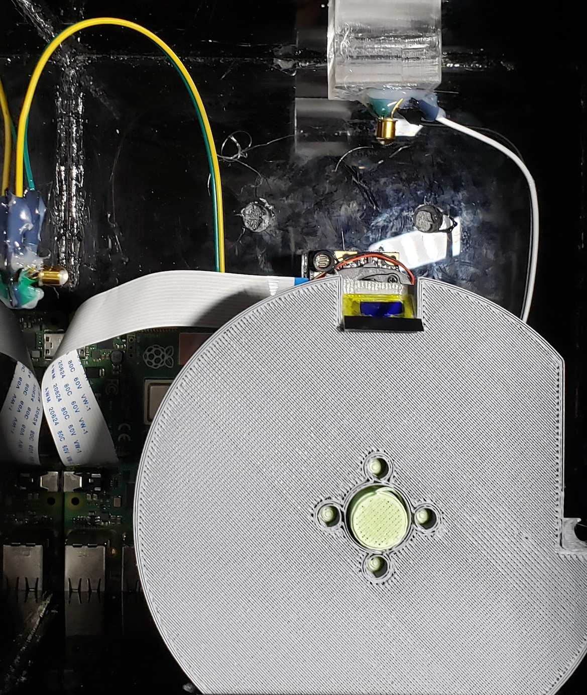
Imaging Setup Optimizations
Moved Camera & LED closer to LFA Stage
Added tape directly below lense edge to prevent some glare on camera
Placed tube around camera to prevent ambient light from LED affecting camera’s perception of emission
Identified position in which stage is most aligned with camera allowing for max capture of fluorophore emission
Notes:
Akash

Slide 15
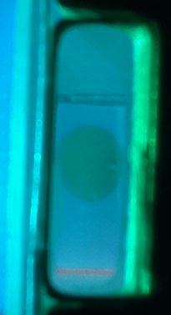
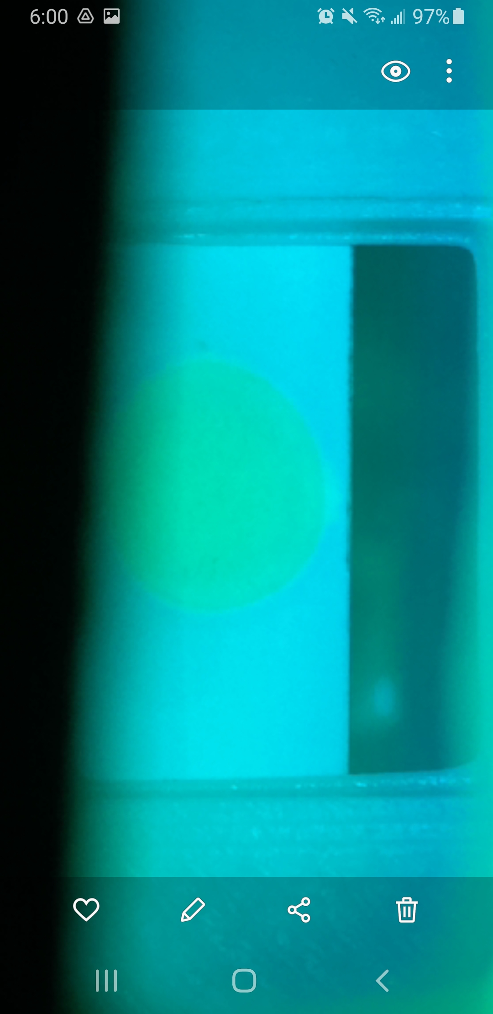
Before & After Optimizations were Implemented
Notes:
Karthik

Slide 16
Summary/Discussion
LFA:
Limit Of Detection: 20nM
Detection range: 20-100nM
Window is relatively narrow, only spans 1 order of magnitude, wider range of detection is desirable
Imaging Device:
Modeled, created, and programmed the imaging device
Detects fluorescence on bright LFAs
Can use smartphones to take & access photos from PI
Is prepared to multiplex both 495 and 770 nm fluorophores
Notes:
Akash

Slide 17
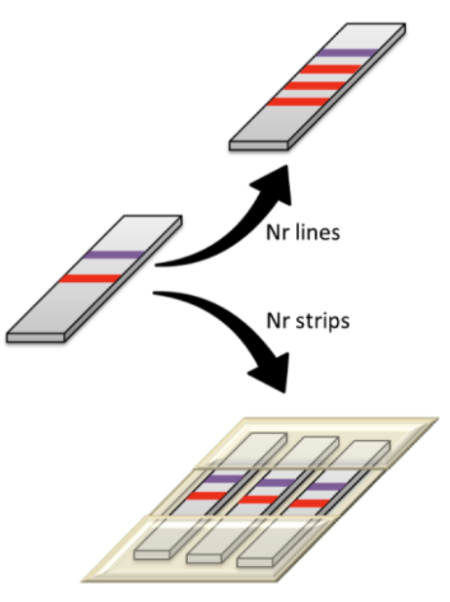
Future Directions
Further characterizing and optimizing LFA/Imaging device with each other
LOD and detection range characterization
Automate the imaging analysis
Create python script to not only capture image, but analyze image with few inputs from the user
Multiplex the LFA with other proteases/biomarkers
Anfossi et al, Biosensors 2019
Notes:
Akash

Slide 18


Acknowledgements
We would like to thank Dr. Kwon and Julia Kudryashev for their guidance and Dr. Wheeler, Anahid Foroughishafiei, and the other TAs for their continued support throughout the course of this project.

Slide 19
Questions?

